Slide 1

Project-1
Group 3 (Sam, Saeed, Julia & Prateek)
QUICKR PICKR

Slide 2

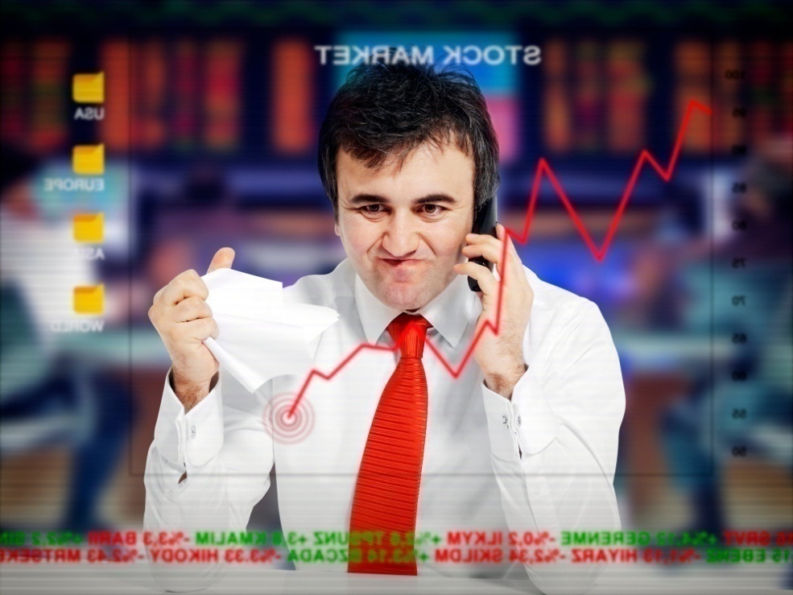
INTRODUCTION WHO ARE WE
Speaker: Julia
Background
Finding best stocks to invest in stock market can be a tedious task. From researching stocks, following the market, measuring returns and so many other things …
These tasks can take up so much of your time & energy. And even after thorough research and sound decisions, there’s no guarantee,
it might go from here … to there …
from here …
to there …

Slide 3

THE PRODUCT STAR IS HERE
Speaker: Julia
Salient Features: (Option1)
(Transitioning Effect for Features)
RSI (Relative Strength Indicator)
Forward Price Earnings
Debt Equity Ratio
Total Debt
Salient Features: (Option2)
(Transitioning Effect for Features)
No Fees
User Friendly App
Expert Advices
High-Tech Indicators

Slide 4
LOGO Rationale:
Why this logo?
Gold colored shiny Logo reflects:
Wealth, Money, Prosperity, Investment – A perfect
combination for FinTech Business.
Subconsciously, it attracts the target audience &
appears rich and elegant in design.
Brand Name has a sleek & clear readable FONT.
*NOTE: This slide has justified the logo selection part and will not be a part of main deck.

Slide 5
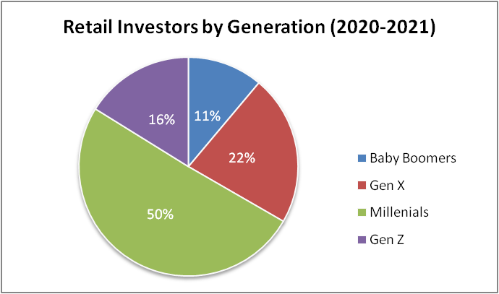

BACKGROUND INSPIRING TALE
Speaker: Saeed
Retail Investors growth ….
As per Schwab Research:
New Retail Investors are not just young people. They are also an older cohort discovering investing for the first time. Generation Investor has a median age of 35, compared with pre-2020 investors whose median age is 48, Schwab said. More than 50% of Generation Investor are millennials, 22% are Gen X, 16 are Gen Z and 11% are baby boomers.
Source: https://www.cnbc.com/2021/04/08/a-large-chunk-of-the-retail-investing-crowd-got-their-start-during-the-pandemic-schwab-survey-shows.html
Define Success
Three basic rules to successfully trade the stock market:
Knowledge + Experience + Effort = SUCCESS
Missing one parameter can cost a lot:
Loss : Break Even : Make Profit
80% : 10% : 10%
Source: https://www.wealthwithin.com.au/learning-centre/share-trading-tips/trading-the-stock-market
Source: https://marklyck.medium.com/why-80-of-day-traders-lose-money-78d51b10fe25

Slide 6


BACKGROUND INSPIRING TALE
Speaker: Saeed
Meet Charlie
Saeed will cover his story to support this slide …
A TRUE Story
FROM
To

Slide 7


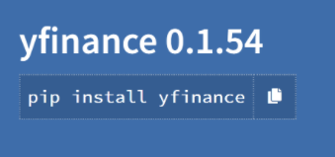


DESIGN TECHNICAL SPECIFICATIONS
Speaker: Sam
Packages
yFinance - Provides historical market data from Yahoo! finance
Numpy - Python library that provides multidimensional array objects, derived objects, and routines for faster operations
Matplotlib - Python library that provides static, animated, and interactived visualizations
fire - Command line interface, help page, and entry-point
questionary - Interactive user prompts and dialogs
SYSTEMS

Slide 8
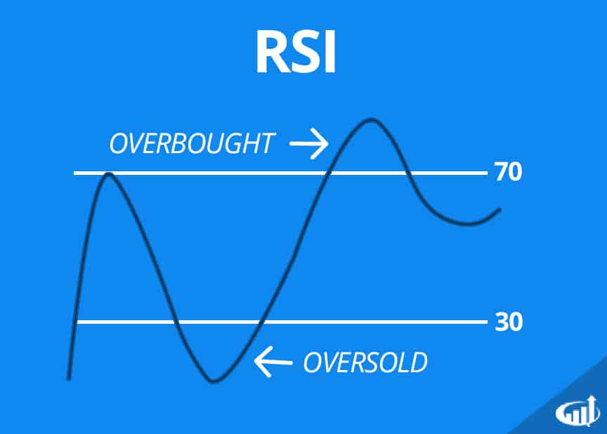
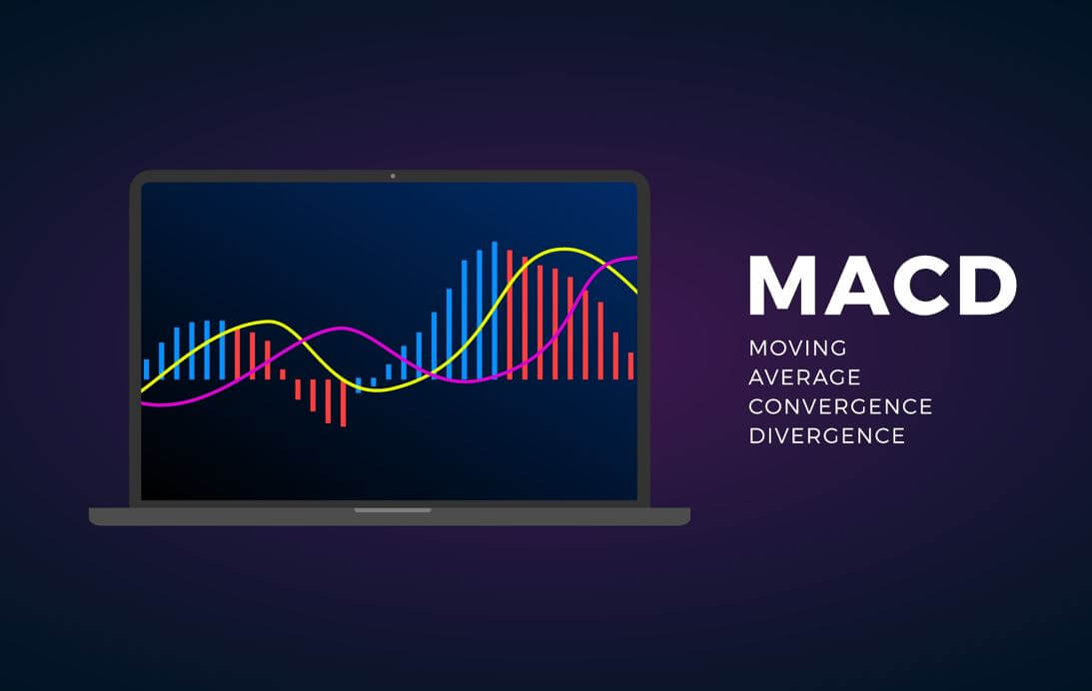
DESIGN Indicators
Speaker: Sam
Relative Strength Index
MACD
SYSTEMS

Slide 9
QUICKR PICKR GET RICH QUICKER
Speaker: Prateek
Closure with Conclusion of overall presentation
Prateek will cover this part …

